Slide 1
City Planning and Growth
By: Cameron Lester

Slide 2
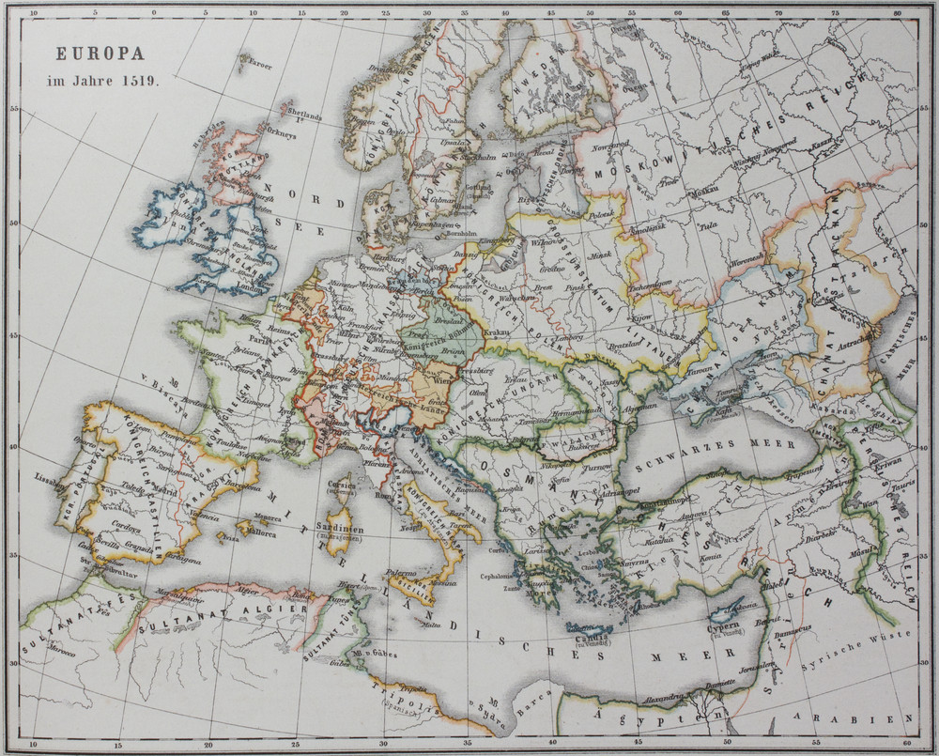
Challenges of European Cities
There were 4 main issues that European cities had to deal with at this time:
The issue of housing and housing locations
The sewage dilemma
The birth of the Metro
The creation of steam trains and more efficient railways

Slide 3
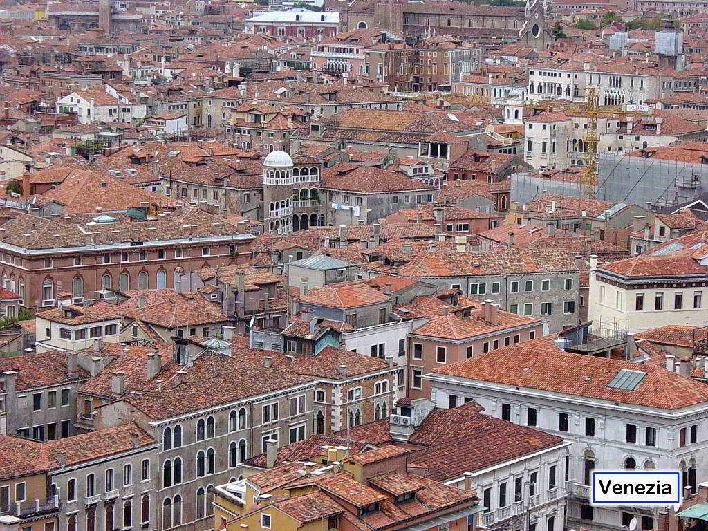
How were the houses organized in early 19th century cities?
In the city a house would be placed back-to-back of other houses and could share up to 3 walls with other homes; which is what we see in Venice.
Rooms were organized as a 3 room system: the top room being the bedroom, the bottom being a living room and a kitchen, and the cellar would be the last level underground which some landowners would rent out to the poor.
But wait I want
to know more!!
(Click for more information
about these homes)
Notice how close these houses are and how little room there is for the streets. Consider that the only place they had to build at this point in time was up!

Slide 4
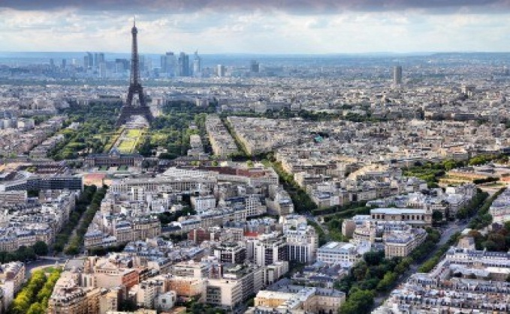
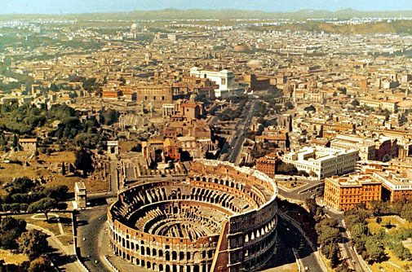
How did cities change in the mid to late the 19th century?
The use of long, wide roads meant that rioters would not only be seen quicker, they would not be able to put up defenses nearly as quickly
After the multiple revolutions of the 1830s and especially the June Days, city planners begin to create new legislation making it mandatory for a certain amount of room to be placed in between houses to prevent such things as barricades from being put up so easily which we can see in modern Paris or Italy today.
Learn more about the man behind Paris’ redesigning: Georges Haussman!

Slide 5
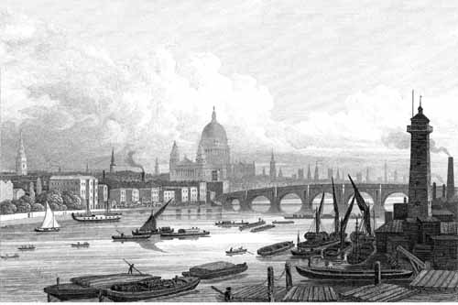
Infrastructure and the problems of cities
A big problem facing these cities, especially with how cramped they were, was the development of good infrastructure which includes the issues of the metros, sewage,
and railways.
➔
London Bridge prior to its “falling down.”
What is the history behind that bridge?

Slide 6
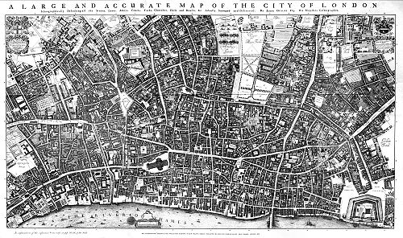
The issues sewage systems of mid 19th century London and Europe
During this time London – and to a larger extent much of Great Britain and Europe – was facing cholera epidemics and “great stinks”.
These “great stinks” were times during the hot summer months in which waste water fermented and stunk up the cities, causing many people to get nauseous. (How delightful!)
A map of London circa 1847

Slide 7
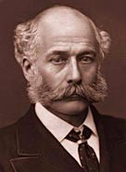
The King of Sewers, Joseph Bazalgette
Joseph Bazalgette had a significant impact on London and its sewer system. His design of a “perfect” sewer system evolved and spread across Europe.
Bazalgette created London’s metropolitan board of works in 1856 and he had a plan that would change the way that sewage was handled in cities across the world for years to come
Joseph Bazalgette
(click for his BBC biography!)

Slide 8
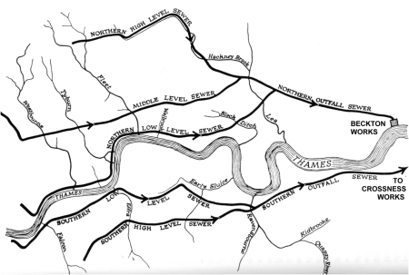
Bazalgette’s Solution
Joseph Bazalgette figured out that the source of these issues had to be coming from the old sewers and the way that waste water was handled.
His plan was to reroute old sewers into new ones behind embankments and NOT into the Thames, this way the drinking water stayed clean, there were no “great stinks” (Oh bummer, I was just getting used to them too!) and the water was the brought to treatment centers to prevent contamination
The sewer line is represented by the solid black lines with arrows pointing towards the direction, as you can see the north side ends with the first treatment plant and the south side leads further down to the second plant.

Slide 9
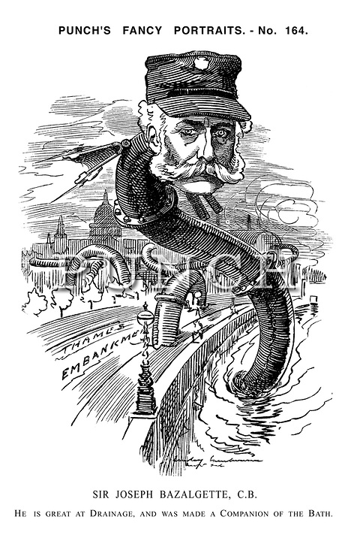
The solution and its lasting effect
The Bazalgette solution led to better health conditions in cities across Europe as it spread.
Cases of cholera went down, and cities began to implement health codes (at least for water) which gives birth to modern systems like the World Health Organization.

Slide 10
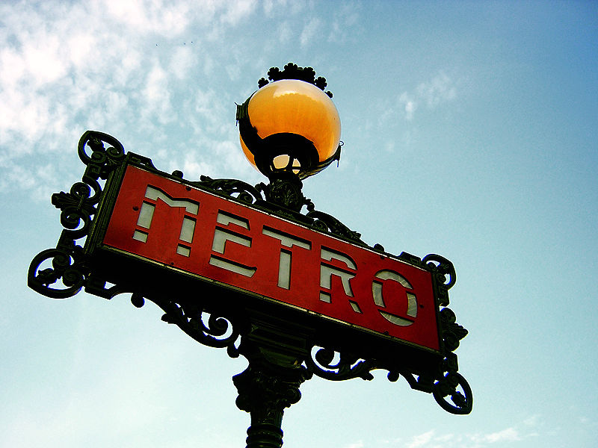
Birth of the Métro/subway system
As European cities such as London and Paris grew they needed a way to get their populous from point A to point B as quickly and efficiently as possible which gave way to the idea of an underground railways system.

Slide 11
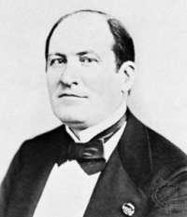
Georges Haussmann
Haussman was the main architect and designer behind Paris’ remodel.
He changed the ways that houses were arranged so that barricades could no longer be made so quickly.
Haussman created an idea for underground railways which is what this portion of the presentation shall focus on, but if you are interested click his image to learn more about him.

Slide 12
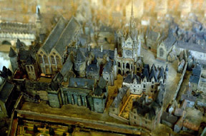
The creation of the railway termini: Convincing the council
Haussmann’s plan of connecting the city through 6 main roads and the new underground railways proved to be a challenging task.
He had to convince the council that the city not only needed it, but that the railways would benefit the city for years to come.
Prior to Haussmann, Eugène Flachat had also attempted this task, and if it was not for Flachat’s writings and plans, Haussmann may not have been able to convince the council of the necessity of the termini.
A painting of the
Termini’s construction in Paris circa 1859.

Slide 13
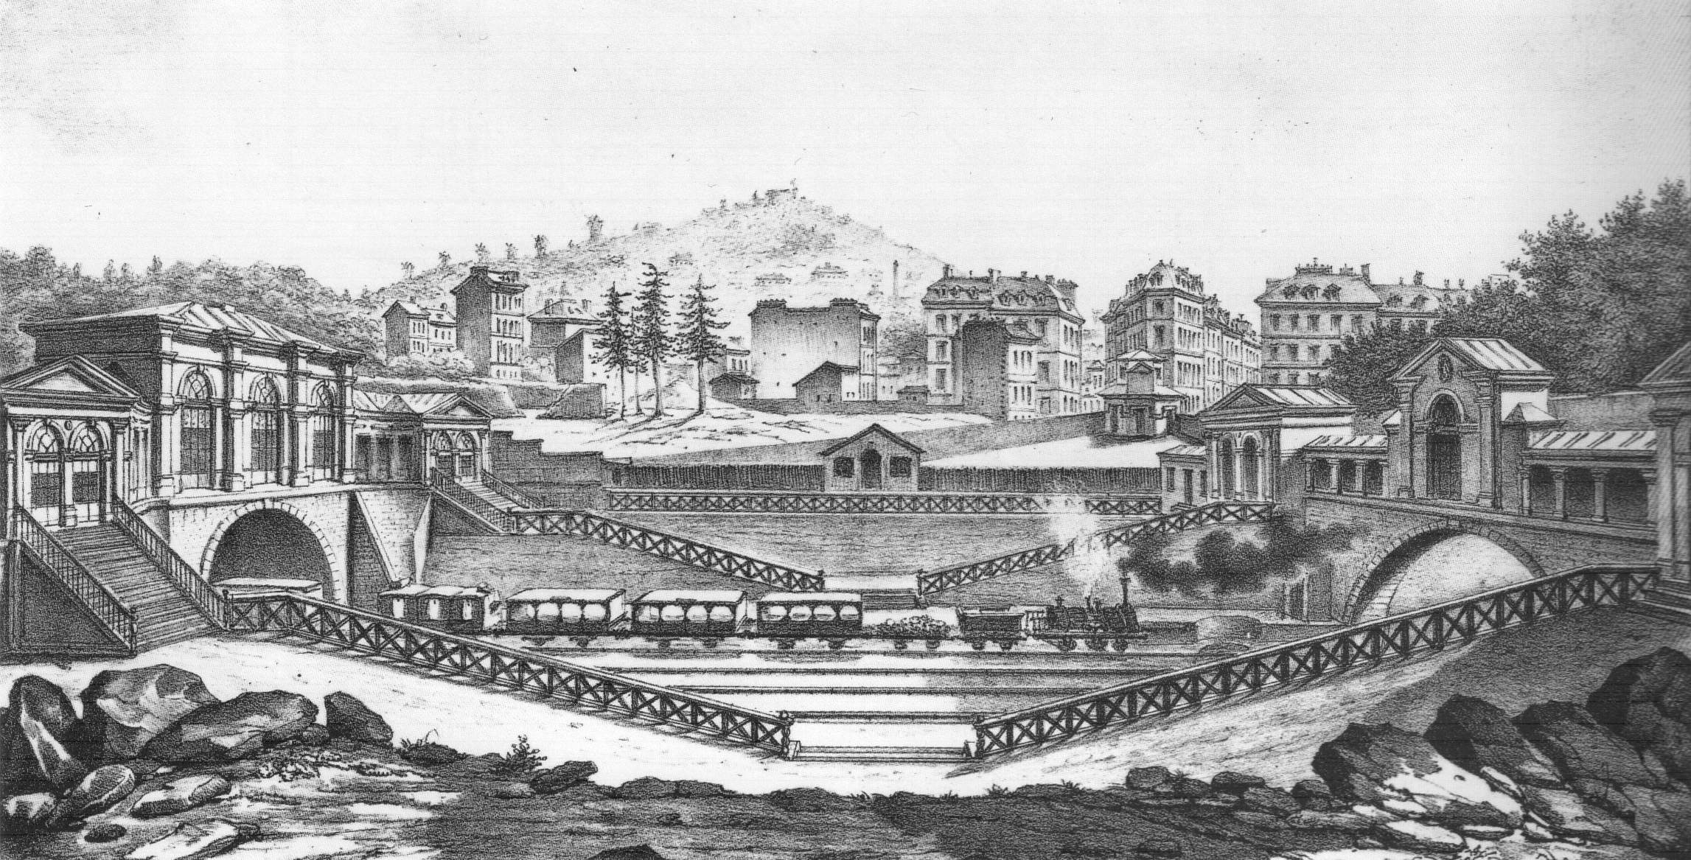
The creation of the railway termini: Connecting Paris
To connect the city in an efficient manner, Haussman and other leading architects planned to connect all stations to the business centre and to extend the roads to help ease traffic issues and the main station would be the Gare Saint-Lazare. This style of organizing the metro system can be seen today in other cities such as New York City and modern day London.
(Paris-Saint Germaine railway)

Slide 14
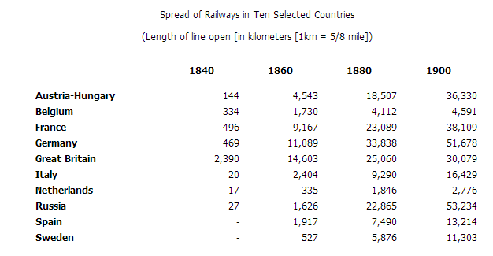
The European Railways: Connecting a continent.
Throughout the 19th century we can see countries expanding railways to accommodate more trade and faster spread of resources thanks to the steam engine powered trains.

Slide 15
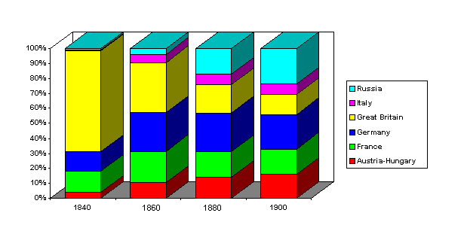
“King of the Tracks”
With the exponential growth of railways across Europe many cities would sprout up to accommodate the locomotives and their engineers that work them, we can see in this graph that Great Britain and Germany controlled the most railways and as such we can assume that they also saw the creation of the most towns during this time.

Slide 16
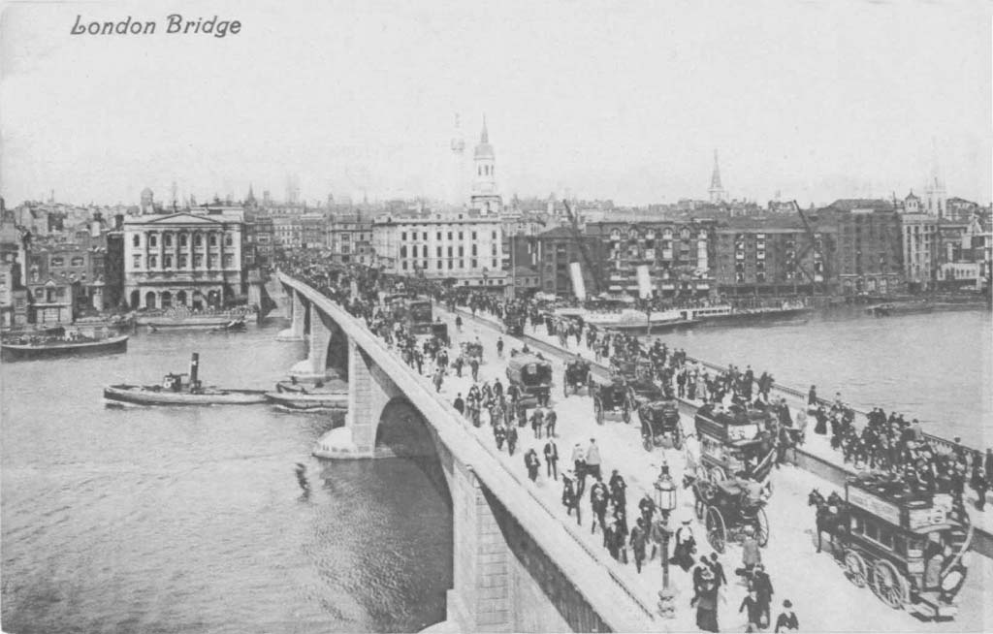
The accommodation of railways in cities and the “Urban Boom”
Beginning with Paris around 1850, most all major cities in Europe began to remodel and reconstruct cities to accommodate the railways.
In 1800, urban areas made up about 40% of the population of Great Britain, and 25% for France and Germany.
By the 1900s urban centers accounted for nearly 80% of the British population, 60% of the German population, and 45% of the French population.
For more information on the “Urban Boom” click the image!

Slide 17
Hyperlink and images
Europe: http://www.old-map-blog.com/wp-content/uploads/2010/06/map_19th_centuryKI_europe_in_the_16th_century.jpg
Venice: http://mousely.com/wiki_image/9/91/VeniceRoofs.jpg
19th Century Homes: http://www.localhistories.org/vichomes.html
Rome: http://www.growvc.com/blog/wp-content/uploads/2011/05/rome-built-in-a-day.jpg
Paris: http://us.123rf.com/400wm/400/400/tupungato/tupungato1207/tupungato120700195/14588766-paris-france--aerial-city-view-eiffel-tower.jpg
London Bridge Image: http://www.old-england.com/thameslondon/images/London%20Bridge%201830s.jpg
London Bridge History: http://barryoneoff.co.uk/html/london_bridge.html
London Bridge is falling down: http://www.youtube.com/watch?v=vTvNwAT29Lo
Joseph Bazalgette: http://www.bbc.co.uk/history/historic_figures/bazalgette_joseph.shtml
Map of London 1847: http://upload.wikimedia.org/wikipedia/commons/thumb/6/63/City_of_London_Ogilby_and_Morgan's_Map_of_1677.jpg/500px-City_of_London_Ogilby_and_Morgan's_Map_of_1677.jpg
Sewers: http://historyday.coldray.com/wp-content/uploads/2008/12/sewers.gif
Bazalgette Cartoon: http://cdn.c.photoshelter.com/img-get/I0000ReaYJllxdc0/s/900/720/Victorian-Cartoons-Punch-1883-12-01-262.jpg
Metro: http://upload.wikimedia.org/wikipedia/commons/6/66/Paris_Metro_Sign.jpg
Georges Haussman: http://gallery.sjsu.edu/paris/architecture/Haussman.html
Haussman Image: http://upload.wikimedia.org/wikipedia/commons/0/09/Portrait_haussmann.jpg
Railway city: http://gallery.sjsu.edu/paris/architecture/m02.jpg
Paris-Saint Germain building: http://upload.wikimedia.org/wikipedia/commons/6/63/Victor_Hubert_-_Paris-Saint_Germain_Railway_1837.jpg
Eugène Flachat: http://books.google.com/books?id=umLmjHFZoT4C&pg=PT302&dq=Eugene+Flachat+biography&hl=en&sa=X&ei=jwcKUfHSIeWZyQHdjYDwDw&ved=0CC0Q6AEwAA
Railways and Graphs: http://www.fordham.edu/halsall/mod/indrev6.asp
The effect of the railways: http://www.suu.edu/faculty/ping/pdf/TheRailwayJourney.pdf
Urban London image: http://www.oldukphotos.com/graphics/England%20Photos/London,%20London%20Bridge%201900's.jpg

